Slide 1
SEMANTIC PROCESSING

Slide 2
Semantic processing
Semantic processing is about understanding the meaning of a given piece of text.
But what do we mean by 'understanding the meaning' of text?
Example
“The bank will not be accepting cash on Saturdays. ”
“The river overflowed the bank.”
The word bank in the first sentence refers to the commercial (finance) banks, while in second sentence, it refers to the river bank.
Our brain can process sentences meaningfully because it can relate the text to other words and concepts it already knows.

Slide 3
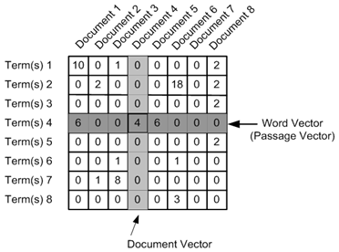
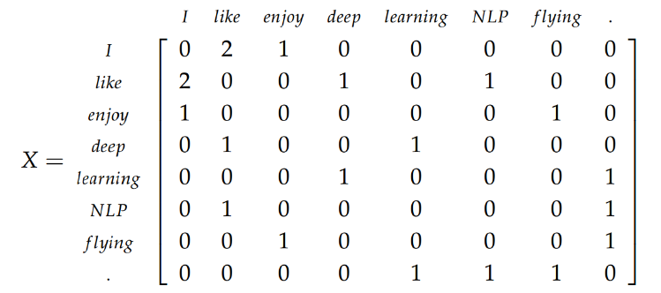
Semantic processing
“words which appear in the same contexts have similar meanings”
To exploit this property, we need to represent words in a format which encapsulates its similarity with other words.
The most commonly used representation of words is using 'word vectors‘.
The term-document occurrence matrix, where each row is a term in the vocabulary and each column is a document (such as a webpage, tweet, book etc.)
The term-term co-occurrence matrix, where the ith row and jth column represents the occurrence of the ith word in the context of the jth word.

Slide 4
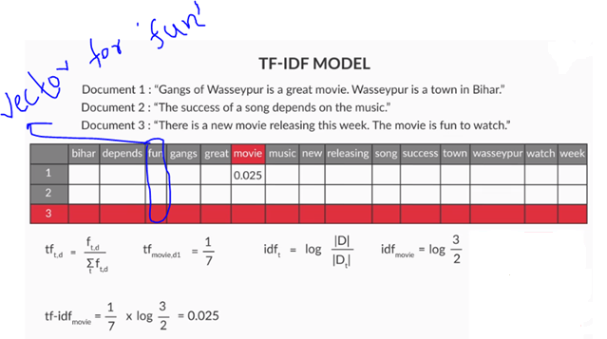
occurrence matrix
Tf-idf stands for term frequency-inverse document frequency, and the tf-idf weight is a weight often used in information retrieval and text mining. This weight is a statistical measure used to evaluate how important a word is to a document in a collection or corpus. The importance increases proportionally to the number of times a word appears in the document but is offset by the frequency of the word in the corpus.
TF(t) = (Number of times term t appears in a document) / (Total number of terms in the document).
IDF(t) = log (Total number of documents / Number of documents with term t in it).

Slide 5
co-occurrence matrix
There are two ways of creating a co-occurrence matrix:
Using the occurrence context (e.g. a sentence):
Each sentence is represented as a context (there can be other definitions as well). If two terms occur in the same context, they are said to have occurred in the same occurrence context.
Skip-grams (x-skip-n-grams):
A sliding window will include the (x+n) words. This window will serve as the context now. Terms that co-occur within this context are said to have co-occurred.
“Man stumbled seconds Dursley man cloak upset knocked ground”
(Man, stumbled) (Man, seconds) (Man, Dursley) (Man, man)
(stumbled, seconds) (stumbled, Dursley) (stumbled, man) (stumbled, cloak)
(seconds, Dursley) (seconds, man) (seconds, cloak) (seconds, upset)
(Dursley, man) (Dursley, cloak) (Dursley, upset) (Dursley, knocked)
(man, cloak) (man, upset) (man, knocked) (man, ground)
(cloak, upset) (cloak, knocked) (cloak, ground)
(upset, knocked) (upset, ground)
(knocked, ground)

Slide 6
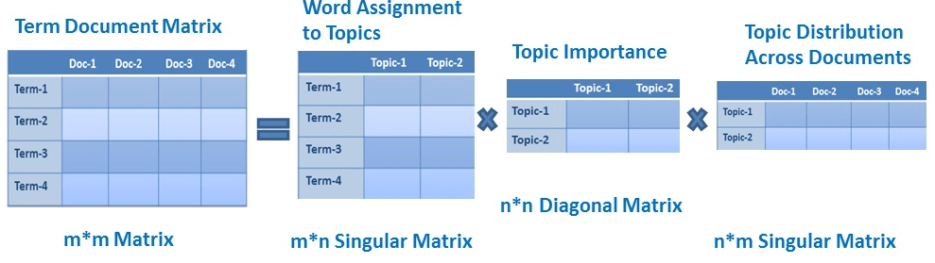
Latent Semantic Analysis
The occurrence and co-occurrence matrices have really large dimensions (equal to the size of the vocabulary V). This is a problem because working with such huge matrices make them almost impractical to use.
Word embedding's are a compressed, low dimensional version of these mammoth-sized matrices
Latent Semantic Analysis (LSA) uses Singular Value Decomposition (SVD) to reduce the dimensionality of the matrix.

Slide 7
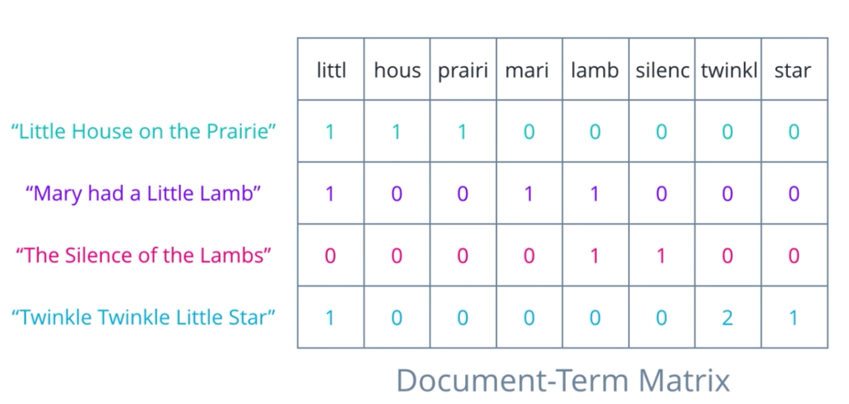
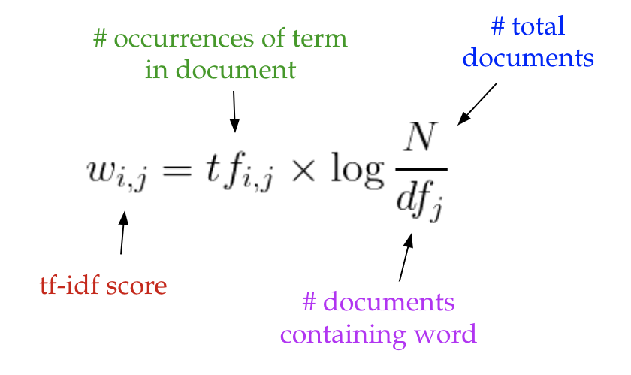
LSA
Latent Semantic Analysis, or LSA, is one of the foundational techniques in topic modeling. The core idea is to take a matrix of documents and terms — and decompose it into a separate document-topic matrix and a topic-term matrix.
Step 1 : Generate our document-term matrix A
Notes:
Intuitively, a term has a large weight when it occurs frequently across the document but infrequently across the corpus. The word “build” might appear often in a document, but because it’s likely fairly common in the rest of the corpus, it will not have a high tf-idf score. However, if the word “gentrification” appears often in a document, because it is rarer in the rest of the corpus, it will have a higher tf-idf score.

Slide 8
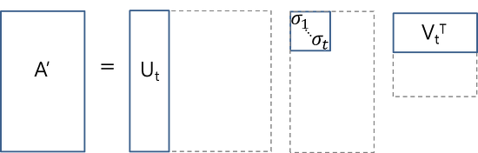

LSA
Step 2 : Perform Dimensionality reduction on the matrix A
This dimensionality reduction can be performed using truncated SVD. SVD, or singular value decomposition
U ∈ ℝ^(m ⨉ t) emerges as our document-topic matrix, and V ∈ ℝ^(n ⨉ t) becomes our term-topic matrix.
keeping the t most significant dimensions in our transformed space.
Notes:
singular value decomposition, is a technique in linear algebra that factorizes any matrix M into the product of 3 separate matrices: M=U*S*V, where S is a diagonal matrix of the singular values of M

Slide 9
TOPIC MODELING
Latent Dirichlet Allocation
LDA is a matrix factorization technique.
LDA represents each document as mixtures of topics containing words with certain probabilities.
The DTM shows a corpus of N documents D1, D2, D3 … Dn and vocabulary size of M words W1,W2 .. Wn. The value of i,j cell gives the frequency count of word Wj in Document Di.
 | W1 | W2 | W3 | Wm
D1 | 0 | 2 | 1 | 3
D2 | 1 | 0 | 4 | 0
D3 | 3 | 0 | 0 | 1
Dn | 0 | 4 | 1 | 0
Document-Term Matrix (DTM)

Slide 10
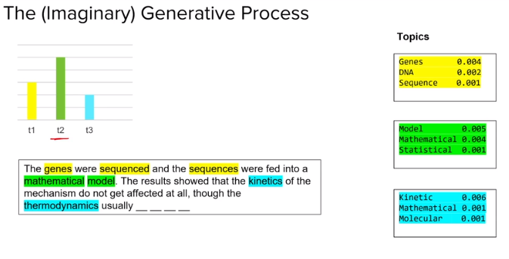
TOPIC MODELING
LDA converts this DTM into two lower dimensional matrices – M1 and M2.
It Iterates through each word w for each document d.
Each word w is assigned to a topic k with a probability P (which is a product of two probabilities p1 and p2.)
P1 – p(topic t / document d) = the proportion of words in document d that are currently assigned to topic t.
P2 – p(word w / topic t) = the proportion of assignments to topic t over all documents that come from this word w.
 | K1 | K2 | K3 | Kj
D1 | 1 | 0 | 1 | 0
D2 | 1 | 1 | 2 | 3
D3 | 3 | 0 | 0 | 1
Dn | 0 | 2 | 0 | 0
 | W1 | W2 | W3 | Wm
K1 | 3 | 1 | 1 | 3
K2 | 0 | 3 | 0 | 0
K3 | 1 | 0 | 3 | 1
Kn | 2 | 1 | 0 | 0
Document-Topics Matrix
M1
Topic-Terms Matrix
M2

Slide 11
Word2Vec
Problems with the text feature vectorizers like count vectorizers and TFIDF vectorizers are:
High Dimensionality
Limited vocabulary
Word Embeddings are a compressed, low dimensional version of the mammoth-sized text feature vectors
What are the different ways we can generate Word Embeddings ?
Frequency-based approach: Reducing the term-document matrix (which can as well be a TF-IDF, incidence matrix etc.) using a dimensionality reduction technique such as SVD
Prediction based approach: In this approach, the input is a single word (or a combination of words) and output is a combination of context words (or a single word). A shallow neural network learns the embedding's such that the output words can be predicted using the input words.

Slide 12
Word2Vec
TRAINING
There are two popular methods that we can use to train our embedding's weights: skip-gram and continuous bag of words (CBOW).
SKIP-GRAM
The idea behind skip-gram is to take in a word and predict the context words.
E.g. lets generate training data from a sentence like “the quick brown fox jumped over the lazy dog”
We need to predict context words from a target word where the context words are the words to the left and to the right of the target word. We will choose a window size (1 in this case) to decide how far left and right to go. The training data for the sentence above will look like this:
(quick, the),(quick, brown),(brown, quick),(brown, fox) …
The idea is to be able to train our weights so that we predict context words from target words. So when we input ‘quick’, we should receive ‘the’. We do this across the entire training set because we want to adjust the weights for all of our words using all the context we have available.

Slide 13
Word2Vec
CBOW
The continuous bag of words method allows us to create the training data for adjusting our embedding weights in a different way.
Instead of predicting context words from target, we will feed in context words and try to predict the target word. So now the training data (with window of 1) will look something like
( [ ‘the’ , ‘brown’ ] , ‘quick’ )
where we sum the embeddings of ‘the’ and ‘brown’ and expect to predict ‘quick’.
COMPARISON
Though CBOW (predict target from context) and skip-gram (predict context words from target) are just inverted methods to each other, each have their advantages/disadvantage.
Since CBOW can use many context words to predict the target word, it acts like regularization and offers very good performance when our input data is not so large.
However the skip-gram model is more fine grained so we are able to extract more information and essentially have more accurate embeddings when we have a large data set
( Large data is the best regularizer )

Slide 14

#LifeKoKaroLift
Thank You!

